Slide 1
HST 103: History of Bangladesh
T. 5: Syncretism in Medieval Bengal

Slide 2
Context
Medieval period (Middle Ages) is one of the three main periods in history – ancient, medieval and modern
Syncretism: fusion of different religions, cultures or ideas. Syncretism refers to the blending of element from different religious and cultural traditions, creating new practices, beliefs and identities.
In Bengal, medieval period started at the beginning of 13th century when Ikhtiyar bin Bakhtiyar Khalji (a Turko-Afghan) in 1204 till the Battle of Palashi (AKA Plassey) in 1757.
Gradual fusion of different faiths and cultures during those 450 years of mostly Muslim rule in Bengal - known as Medieval syncretism in Bengal.

Slide 3
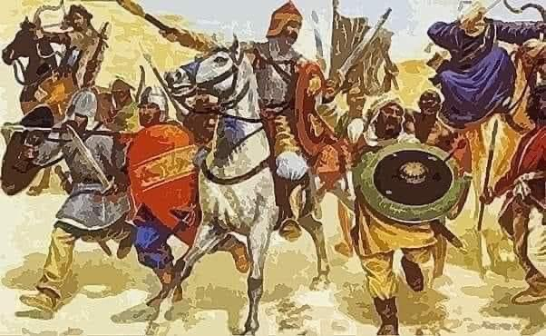
Ikhtiyar Uddin Muhammad bin Bakhtiyar Khalji

Slide 4
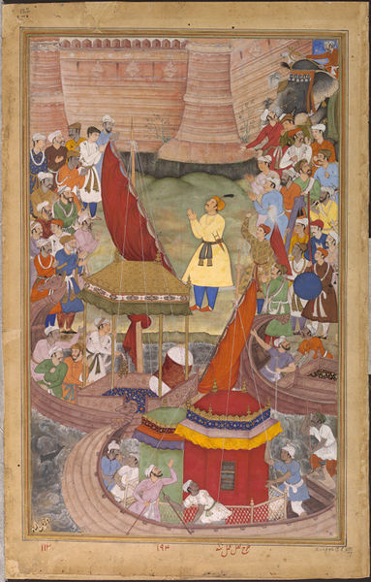
Akbar rejoicing the conquest of Bengal (1586)

Slide 5
Process
Three stages of syncretism: conflict, mutual appreciation and assimilation
It took place mostly between the followers of two religions – Sanatana Dharma (Hinduism) and Islam, but also included different sects of Buddhism (Mahayana, Hinayana)
Pir worship (offshoot of Sufism) attracted both Hindus, Buddhists and Muslims – it became a similar form of worship for many.
Liberal and mystic (supernatural, spiritual) approach of Sufism/Pirism facilitated syncretism
Mostly lower caste Hindus, Muslims (Atraf), and Buddhists) joined the process

Slide 6
Subjects of syncretism
The ‘pir’s – a sect of Sufism – fostered Hindu-Muslim syncretism in Bengal
Pir worshipping was jointly practiced - Pirs were considered demi-gods by their followers – similarities between Pirs and Tantrik gurus: ‘Guru’ and ‘Pir’, ‘Chela’ and ‘Murshid’- Pir was supposed to possess miraculous powers
Pir-ism evolved from Sufism – a mystic (spiritual) interpretation of Islam – Sufis came from Central and West Asia (Iran, Turkey, Iraq etc.)
Vaishnavism was the Hindu counterpart of Sufism
Other Hindu sects like Nath, Sahajiya, etc were also involved
Bauls originated from the syncretism
Bengali Literature (MangalKavyas, Panchali)
Manasa Worship
Satya Pir/Satyanarayan

Slide 7
Cultural Syncretism In Bengal
Art And Architecture
Teracotta Temples
Mosque Design
Music and Performing Arts
Baul Music
Jatra and Theater
Kirtan and Qawwali
Cuisine
Biryani
Korma

Slide 8
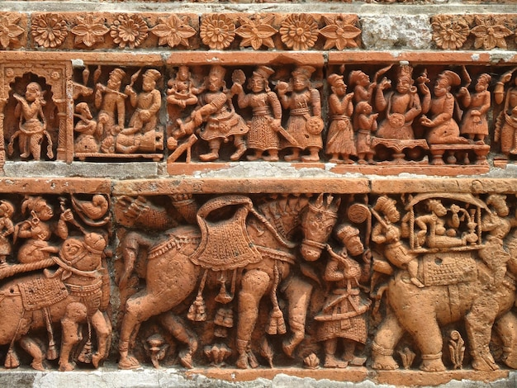
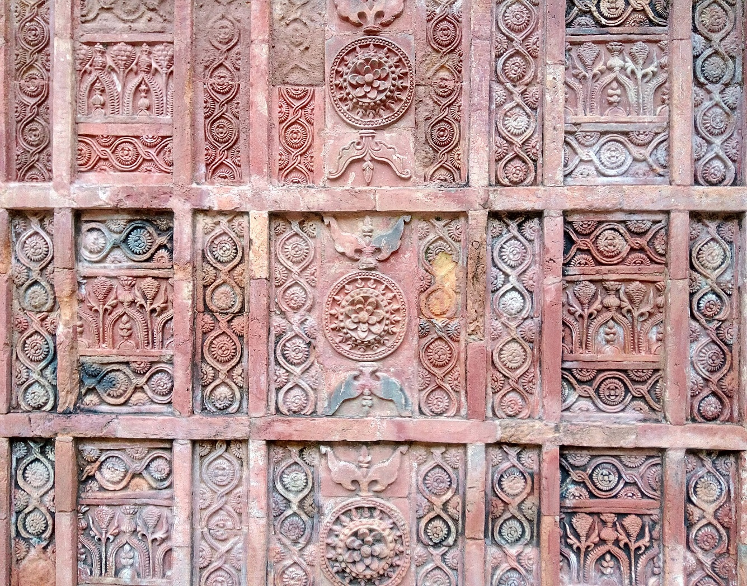
Use of Teracotta on Temples & Mosques

Slide 9
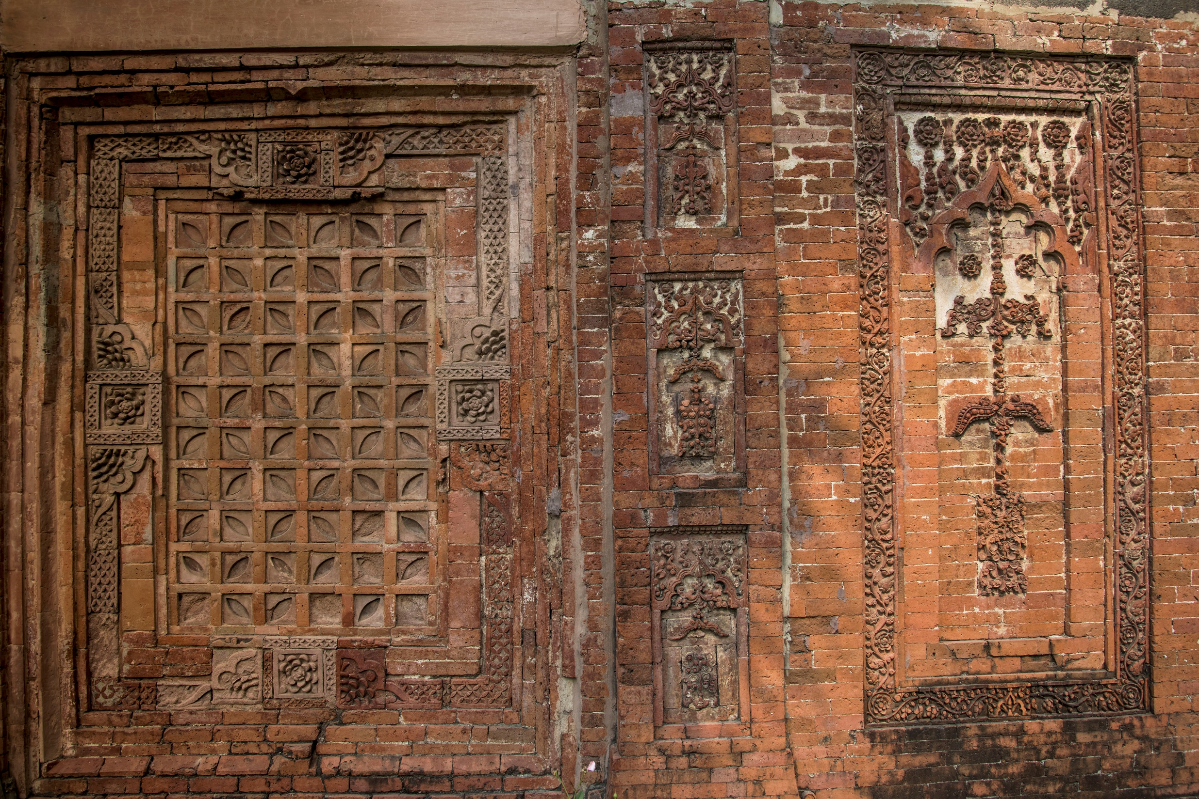

Slide 10
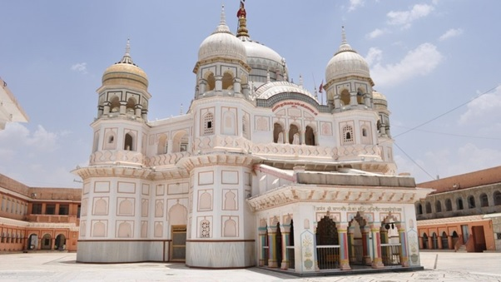
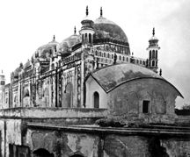
Prannath Temple
Kartalabkhan Masque

Slide 11
Summary
In Bengal syncretism, Muslims and Hindus influenced each other – Mughal emperor Babur called it “Hindustani way of life” - liberal approach of Sufis, their simplicity of religious philosophy attracted others
Syncretism was made easier because both Hinduism were located at the periphery of the center of those religions
Lower classes from both religions were active participants – relief from earthly sufferings (illness, other forms of distress) was a major motive
Absence of caste system and relative equality of Muslims was also a factor
At the same time, orthodox practices continued among both Muslims and Hindus
In short, two parallel religious practices co-existed simultaneously – one ‘Popular’ and the other ‘Orthodox’ – however, syncretic ideas had a strong impact on the entire Bengali society.

Slide 12
Impact
The upper caste Hindus adopted some lower caste rituals (mansa Puja or snake worshipping, for example) in order to placate them
Medieval syncretism should not be overestimated – but it reduced religious conflicts in Bengal
Medieval syncretism moderated religious sentiments and belief system in Bengal, particularly in its Eastern part.
People lived here with communal Harmony because of Syncretism

